Slide 1
CAR RENTAL

Slide 2
INTRODUCTION-
-This project is designed so as to be used by Car Rental Company specializing in renting cars to customers. It is an online system through which customers can view available cars, register, view profile and book car.
- It also provides error message while entering invalid data.
- Every organization, whether big or small, has challenges to overcome and managing the information of customer, car, booking.
- Every car rental has different car need, therefore we design exclusive management system that are adapted to your managerial requirement.
-The car rental project aims to create an efficiency and user friendly platform that allows customer to rent cars from different locations.

Slide 3
OBJECTIVE-
To make sure a user gets his desire car as early as possible; the car rental system will provide a faster response to complete the process through stripe payment.
2. To allow the customers to book space for a group in the case of weeding or corporate parties or meetings.
3. To monitor a vehicle activity and the overall business becomes easy and includes the least of paper work.
4. To provide customers with a convenient and easy to see platform for entering cars from different locations.

Slide 4
TECHNOLOGY USED-
1. React.js: A JavaScript library for building user interfaces.
2. Node.js: A JavaScript runtime environment for server-side applications.
3. Express.js: A web framework for building APIs and server-side applications using Node.js.
4. MongoDB: A NoSQL database for storing and retrieving data.
5. Mongoose: A MongoDB object modeling tool for Node.js.
6. Redux: A state management library for managing the state of the application across components.
7. Bootstrap: A front-end framework for building responsive and mobile-first web applications.
8. CSS (Cascading Style Sheets): A styling language for describing the look and feel of the application.

Slide 5
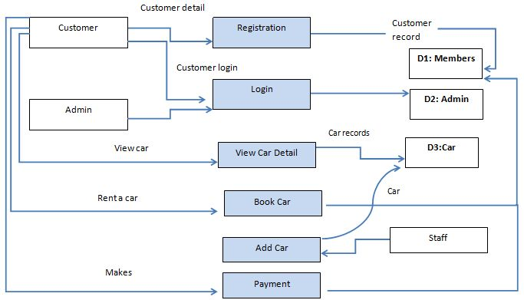
FLOWCHART-

Slide 6
METHODOLOGY-
Login Page: Basically, for any software security is a major concern. So, we have developed a secure application. Without being authenticated no user is allowed to view any other interfaces. For the login page, we have a User ID, Password, Profile. After being authenticated user is authorized to perform certain work according to his/her profile.
Profile Page: Every user has his own profile. From here they can change their information like a correction in name, email id, address, etc. In our system, there are three profiles i.e. Admin, Customer, Car Provider.
View Available Cars: It is a system design specially for large, premium, and small car rental businesses. The user can view Available cars and the user can book for that car. While viewing a car users can view the interior and exterior on our website with a price tag.
Booking Car: If the customer is satisfied with viewing the car details. He/she can be booking a car for a particular date. The booking car interface is a real-time interface that helps the customer to get the best information.

Slide 7
0
Easily Get the Car on rent: The Customer can easily get the car whenever they need to on the rent with the use of this system. They just need a browser or app with an active internet connection.
Give Feedback: The customer will give feedback to the admin. Feedback is confidential information only the admin or owner or higher authorities can view the feedback.
Inquiry: The customer needs to enquire about the availability of the car. Due to human interaction sometimes, the Customer care guy feels he is giving the same piece of 7 information again and again. So, using this interface customer can Enquire about any time, as many times as he wants.
Add Car: The admin can add the car so that the user can see the available cars and book the car. Adding a car means it should be functional.
Manage Rent: The admin can manage the rent so that the user can see the rent and book the car. The cost per mile should be different for different cars.
View Feedback: The admin easily views the feedbacks and solves the query. This feedback should not visible to low-profile workers. Feedback is the backbone of any business if we want to increase our sales or business.

Slide 8
SOFTWARE REQUIREMENTS-
Operating System: Windows, macOS, or Linux •
Node.js: Version 14 or higher •
MongoDB: Version 4.0 or higher
React.js: Version 17 or higher
Text Editor: Any text editor or IDE of your choice like Visual Studio Code, Sublime Text, or Atom.
Package Manager: NPM (Node Package Manager)

Slide 9
REFRENCES-
https://reactjs.org/docs/getting-started.html
https://www.mongodb.com/docs/
https://nodejs.org/en/docs/

